Slide 1
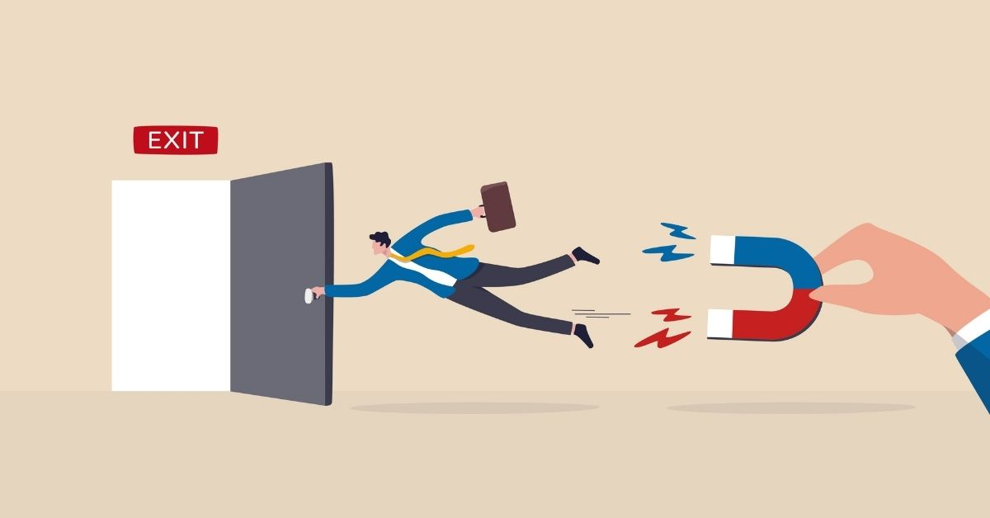
Customer Churn & Charge prediction
By,
ANU SASIDHARAN

Slide 2
OVERVIEW
DESCRIPTION
Churn prediction detecting customers who are likely to cancel a subscription to a service.
Churn is a problem for telecom companies because it is more expensive to acquire a new customer than to keep your existing one from leaving.
Here, IBM provided customer data for Telco industry to predict behavior of the customers. Main objective is that to analyze customer behaviors and develop strategies for customer retention.

Slide 3
OVERVIEW
DATA DICTIONARY
Demographic
Services
Account type
Usage
Monthly charges
Total charges
Target
Churn - Whether customer left the company or still with the company?

Slide 4
PROJECT OBJECTIVE
To predict Customer churn
Factor Affecting Customer Churn
What's the amount to be paid by the customer as total charge ?

Slide 5
METHODOLOGY
Identify Problem Statements.
Data Collection
Exploratory Data Analysis
Feature Engineering
Handling Imbalance Data
Model Selection & Feature Selection
Create and Deploy App

Slide 6
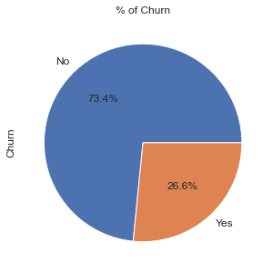
FINDINGS
Telecom company's churn rate is around 26%,
Meaning around 26% of the subscribers from total
left the company during given interval.
From boxplot
75% of churners pay between 60 and 100 dollars a month
One important mark we can see in this plots that 50% of
Churners leave the company before the first year goes by.

Slide 7
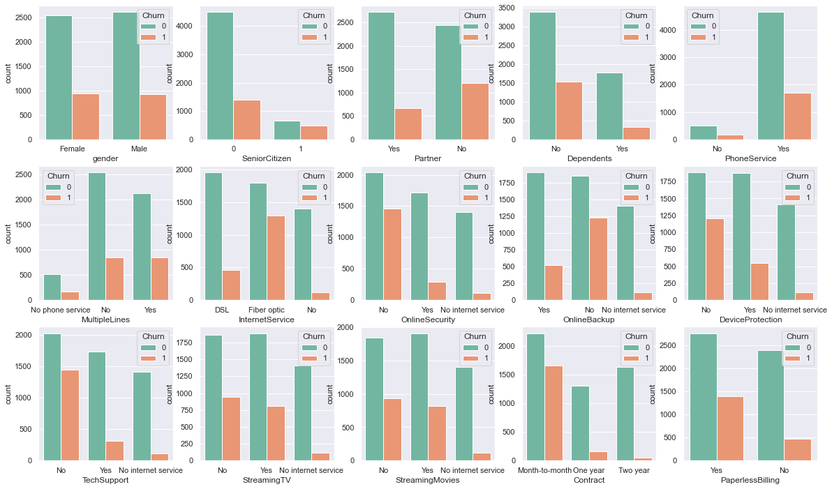
FINDINGS

Slide 8
FINDINGS
From analysis, churn customers are likely to
not have partners and Dependents; Means likely to be Single
have Internet service and specifically Fiber optics
not have online security service, online backup service, device protection service, Tech support service
have streaming TV and streaming Movies services
be with monthly based contract
have paperless billing service
have electronic check payment method

Slide 9
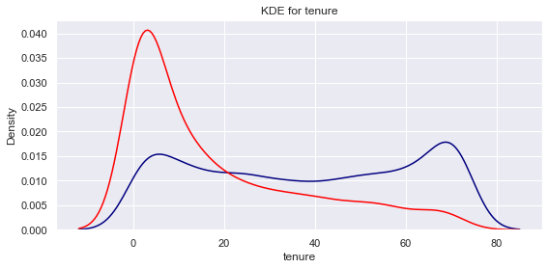
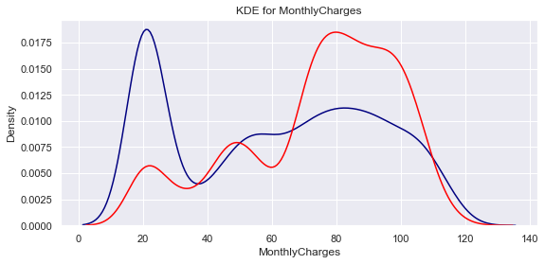
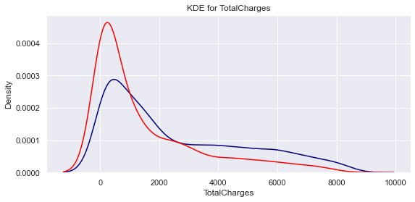
FINDINGS
From the plots above we can conclude that:
Recent clients are more likely to churn. - more likely to leave company who's tenure is less than a year
2.Clients with higher Monthly Charges are also more likely to churn.- more likely to have more than $65 monthly charges
3.Tenure and Monthly Charges are probably important features.

Slide 10
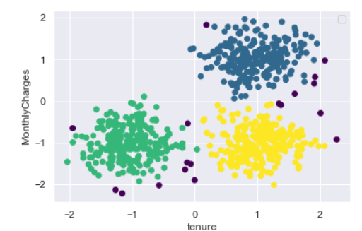
FINDINGS
Relationship between Tenure and Monthly Charges.
Based on DBSCAN cluster graph, we can see that there are three groups.
Low Tenure and Low Monthly Charges (Green cluster)
High Tenure and Low Monthly Charges (Yellow cluster)
High Tenure and High Monthly Charges (Blue cluster)

Slide 11
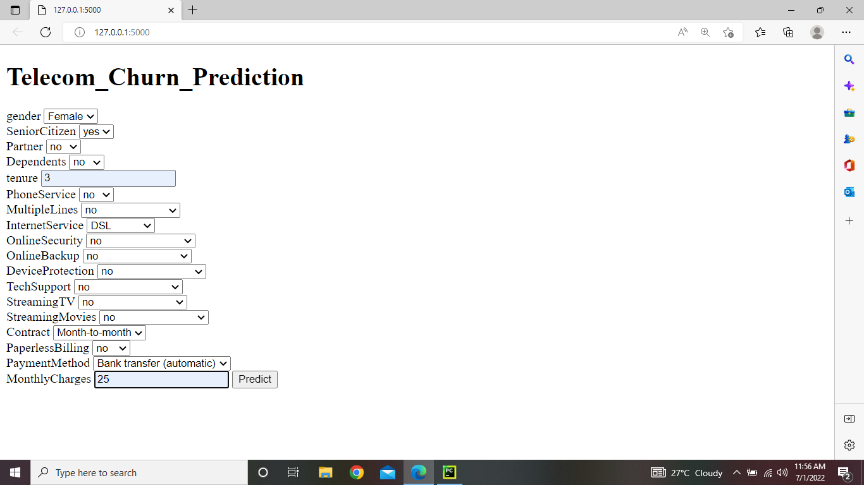
FLASK DEMO
Churn Prediction

Slide 12
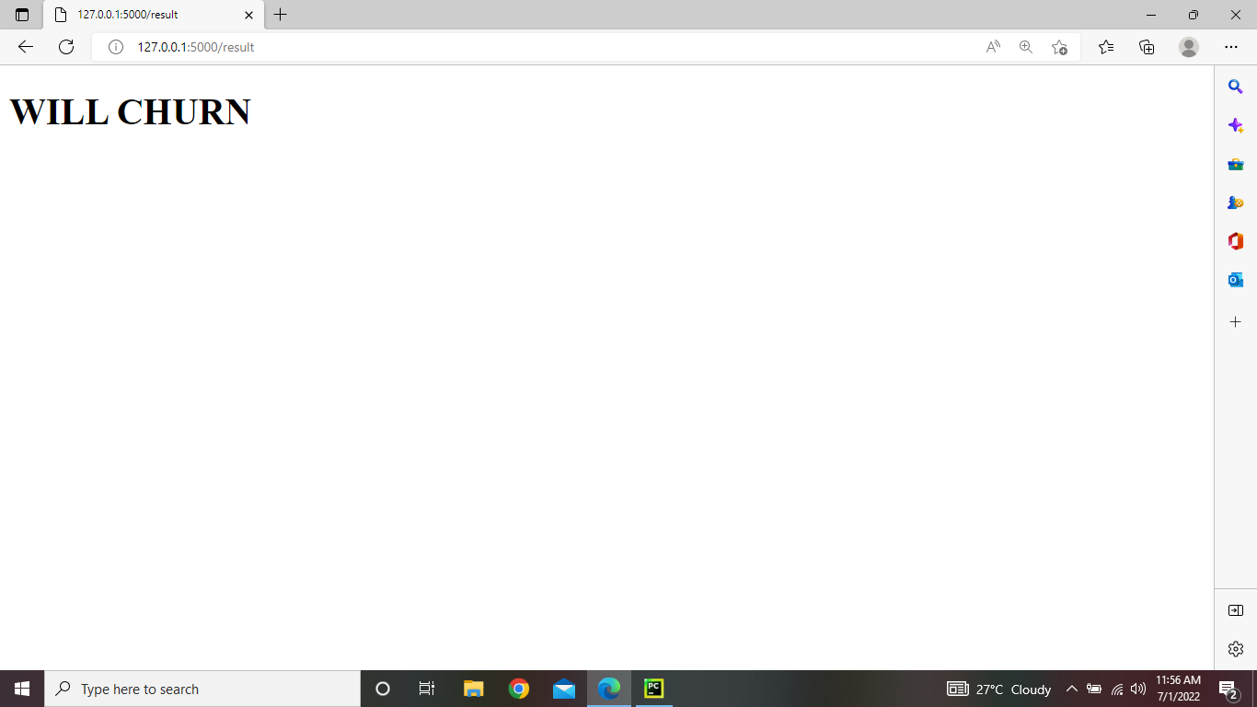
FLASK DEMO
Churn Prediction

Slide 13
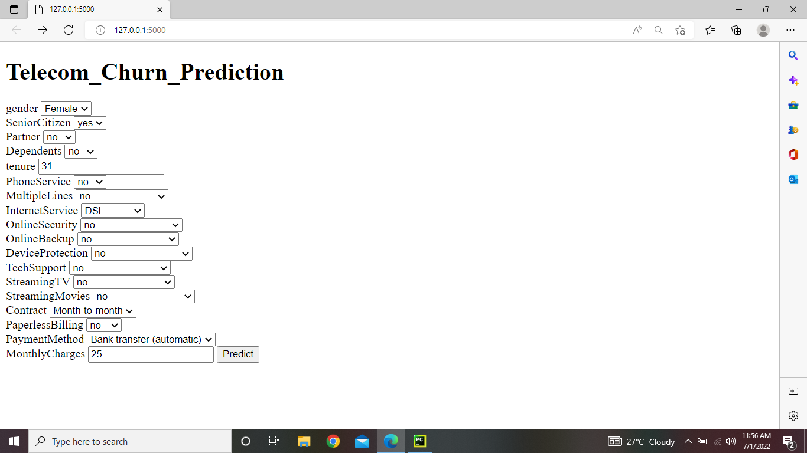
FLASK DEMO
Churn Prediction

Slide 14
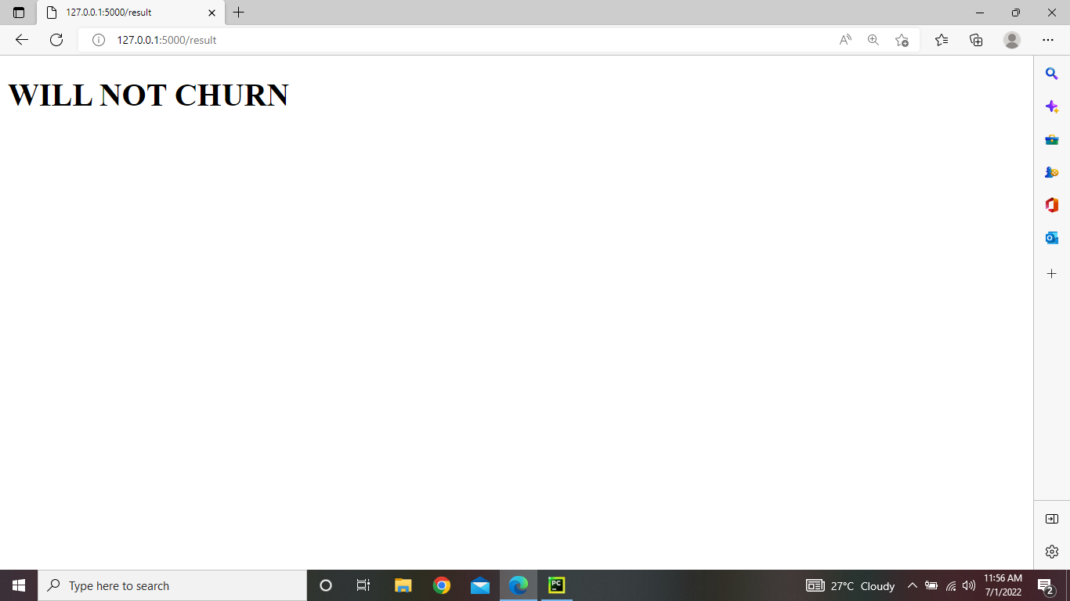
FLASK DEMO
Churn Prediction

Slide 15
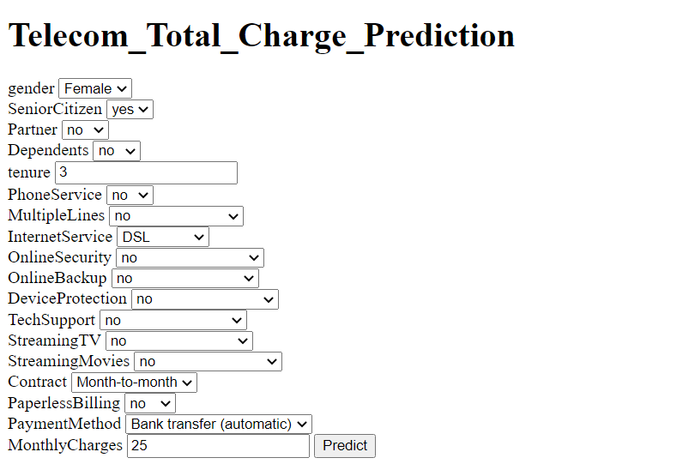
FLASK DEMO
Charge Prediction

Slide 16
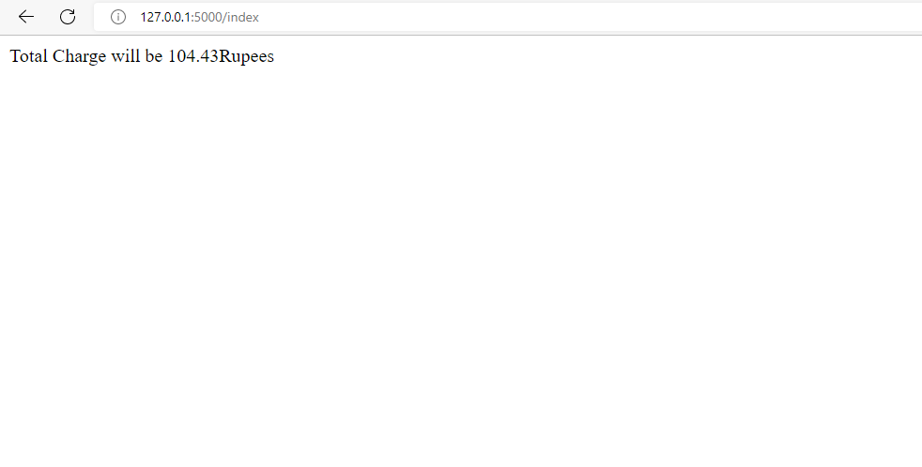
FLASK DEMO
Charge Prediction

Slide 17
PRACTICAL USE OF APP
INSTANTLY CLASSIFY A CUSTOMER WILL CHURN OR NOT.
FREE UP MANPOWER ON ROUTINE TASK

Slide 18
FUTURE WORK
CUSTOMER PRIORITIZATION
SCHEMES THAT CAN BE GIVEN TO CUSTOMER INORDER TO NOT TO CHURN

